Slide 1
School Performance and Geography
Josh Carson & Evan Kramer | Data Governance and Accountability
Notes:
Evan

Slide 2
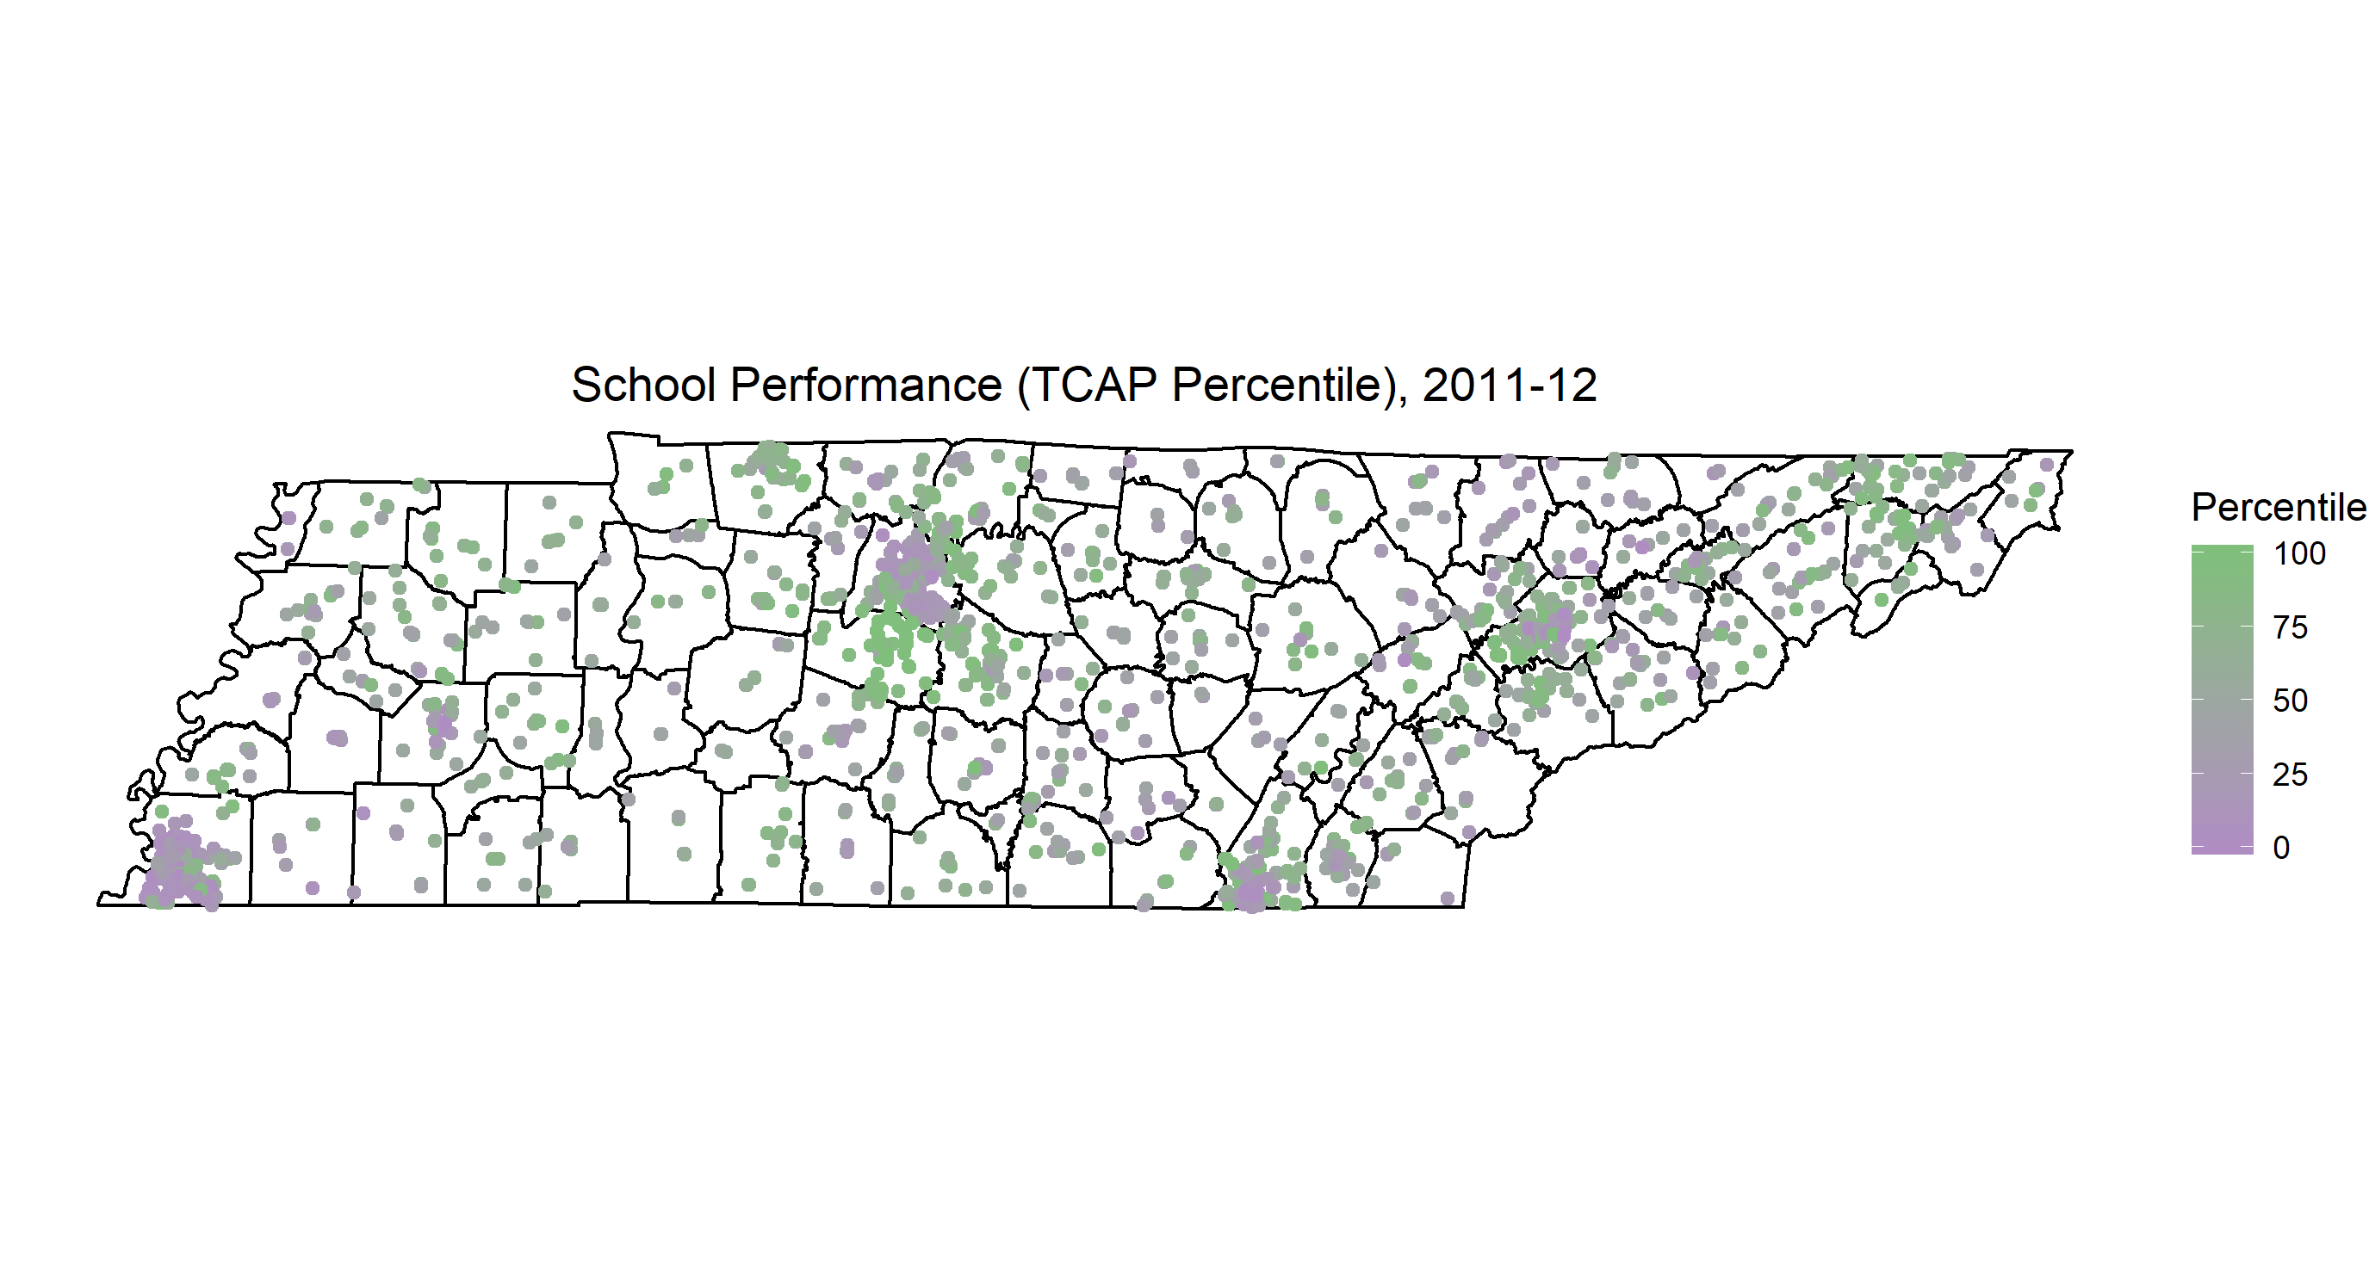
TCAP Percentiles

Slide 3
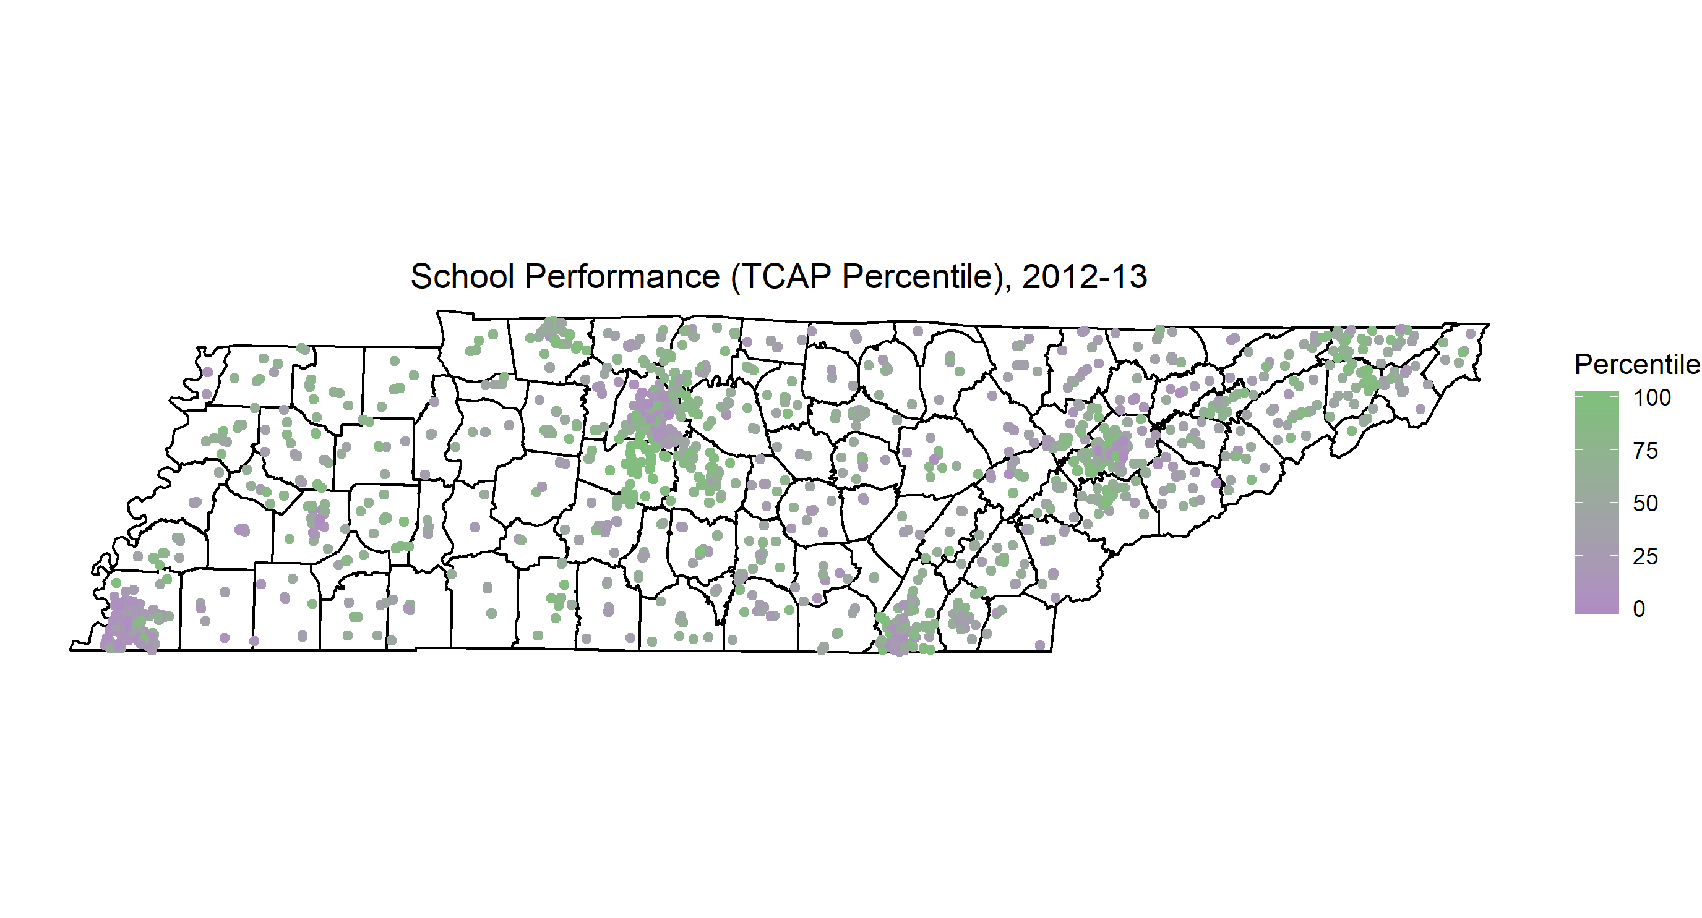

Slide 4
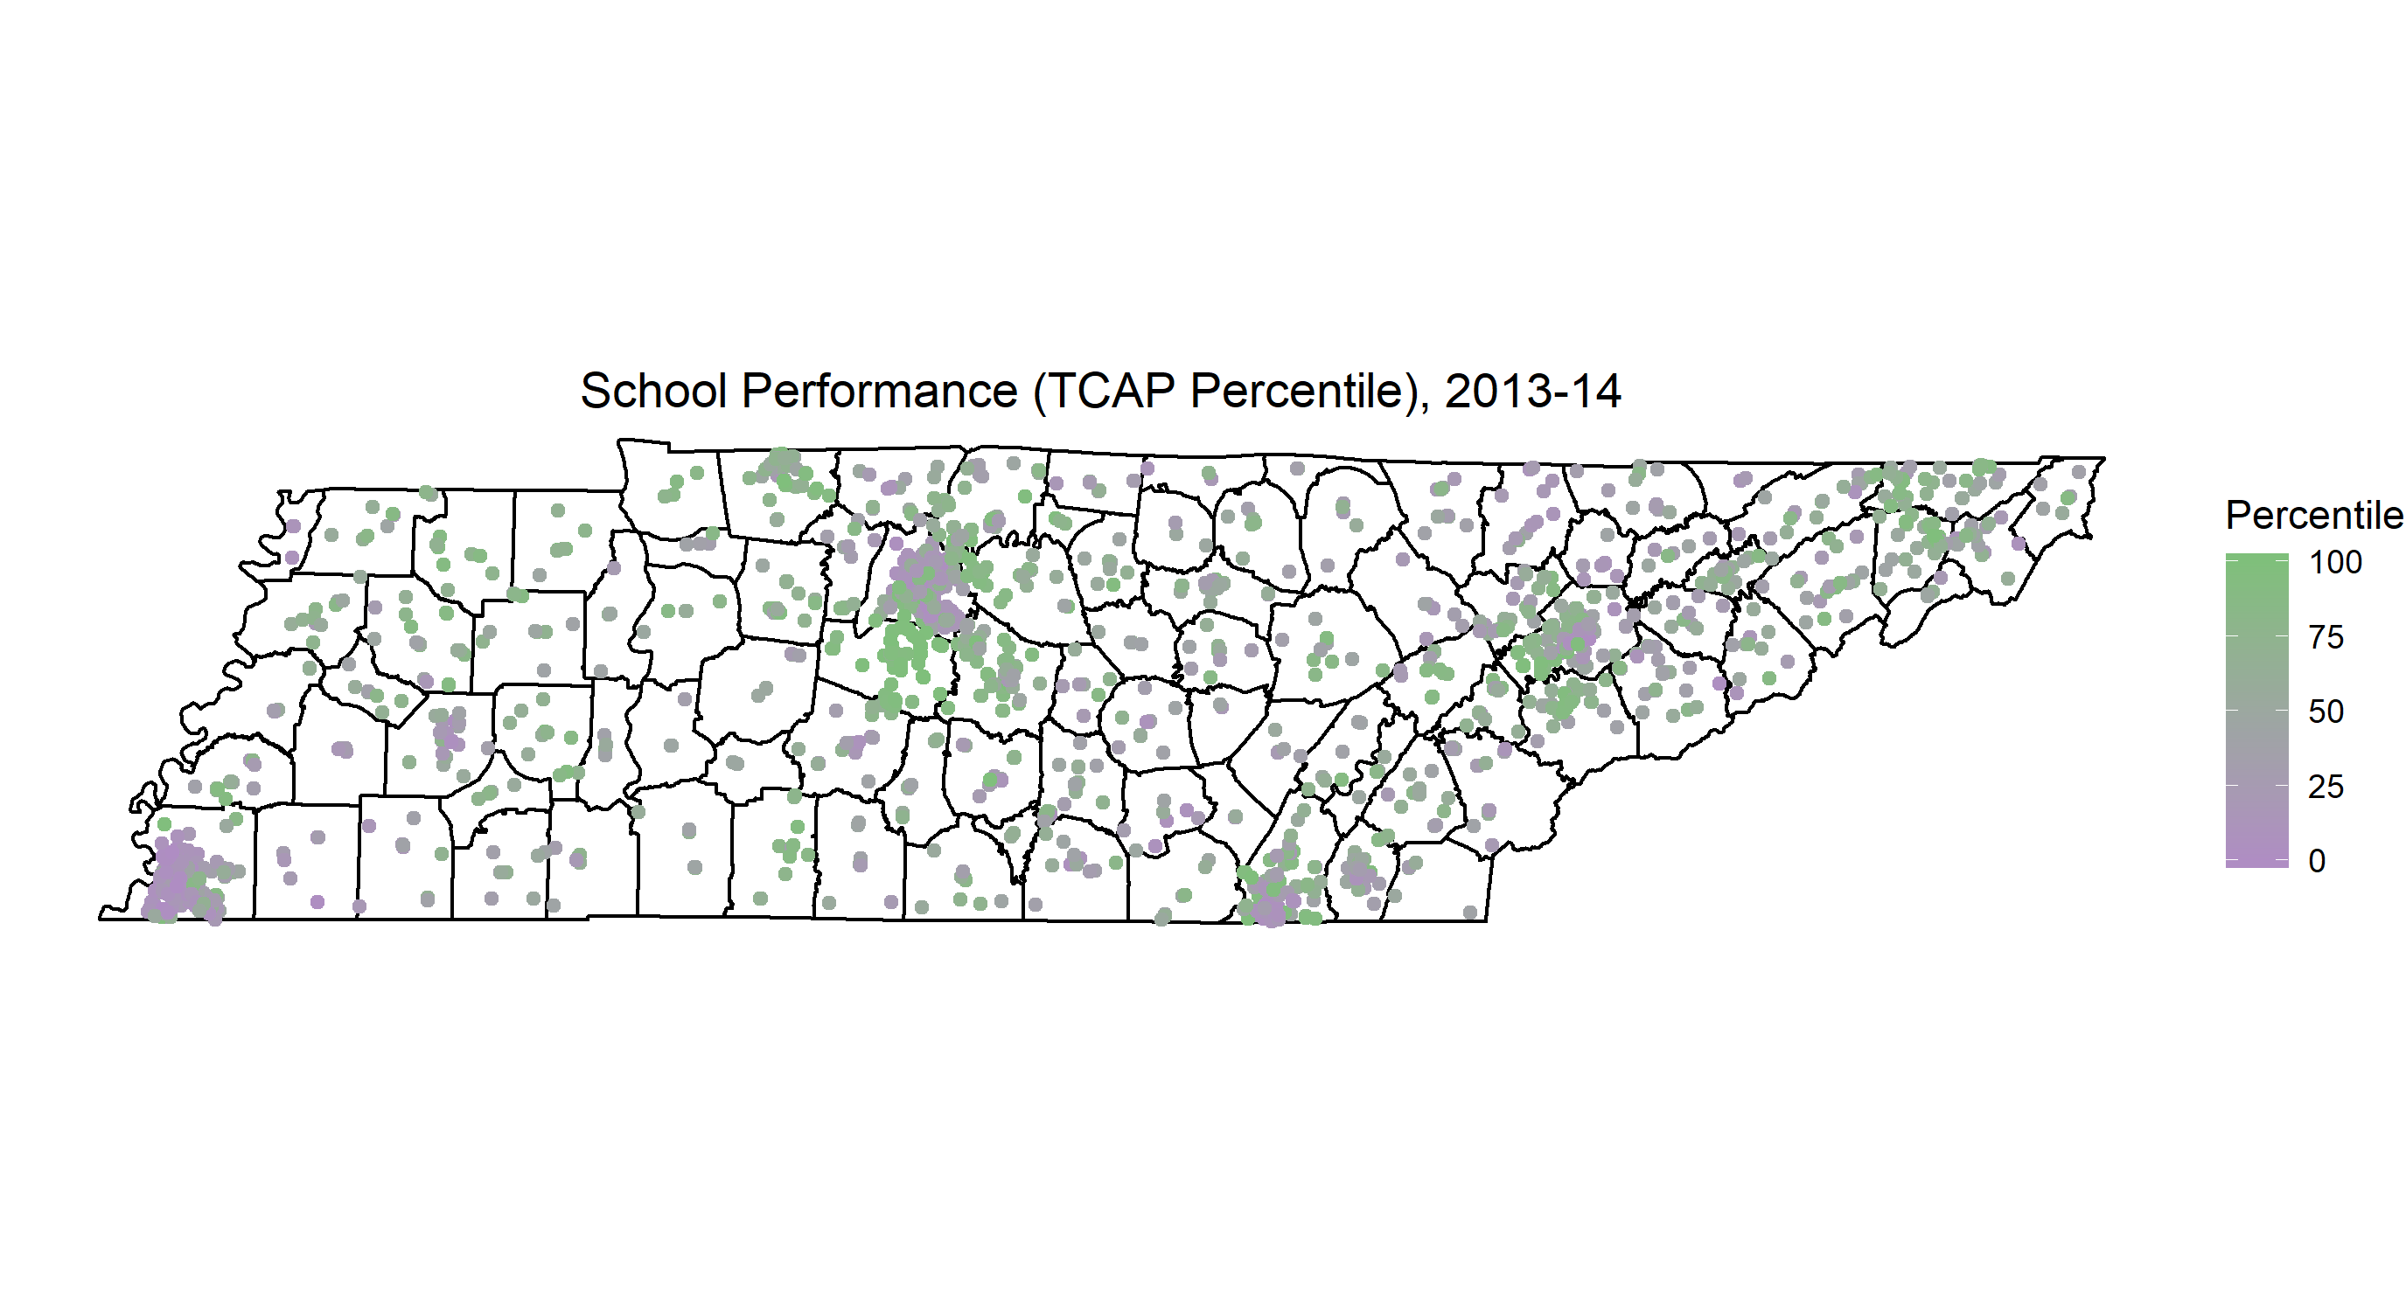
TCAP Percentiles

Slide 5
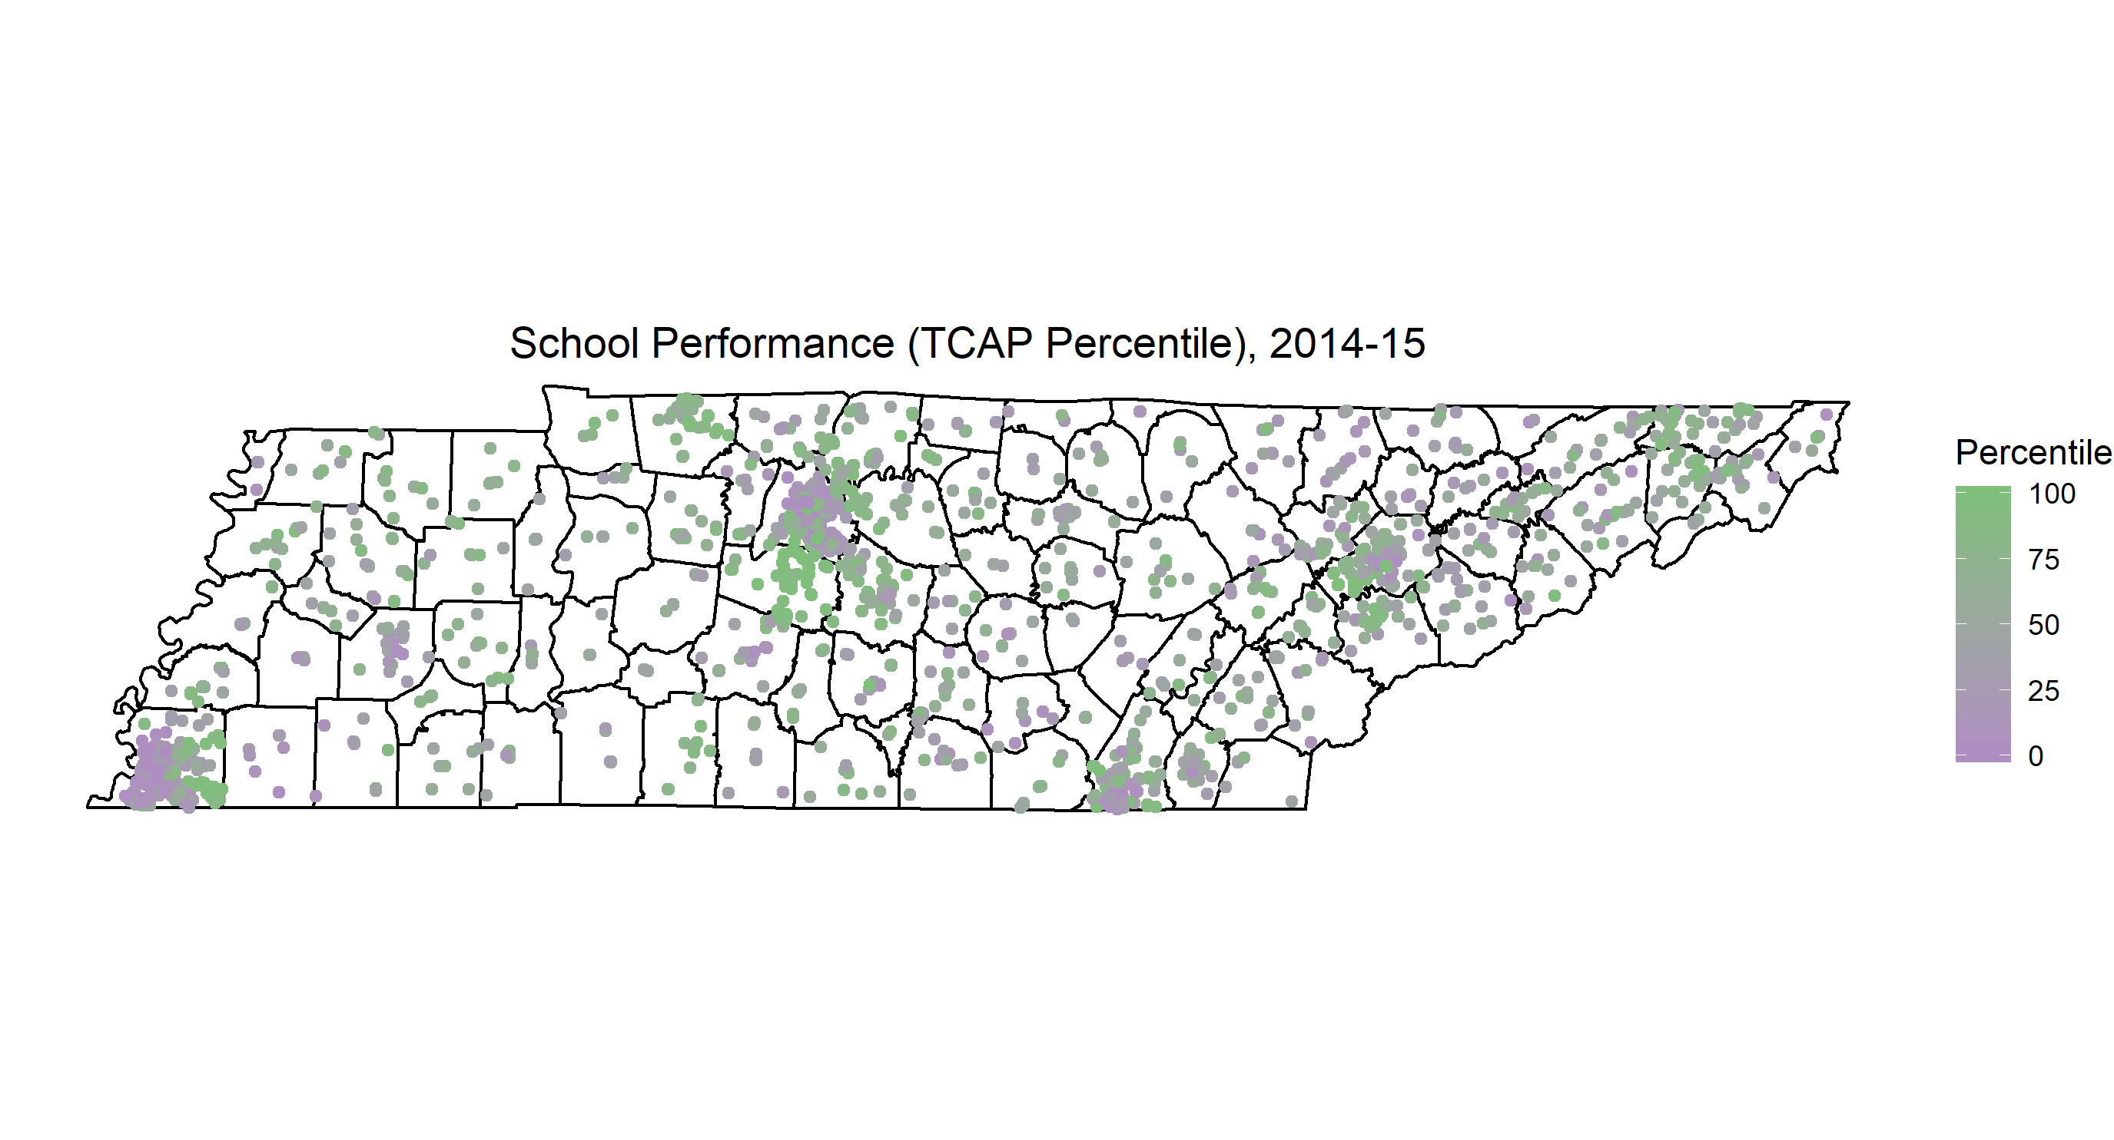
TCAP Percentiles

Slide 6
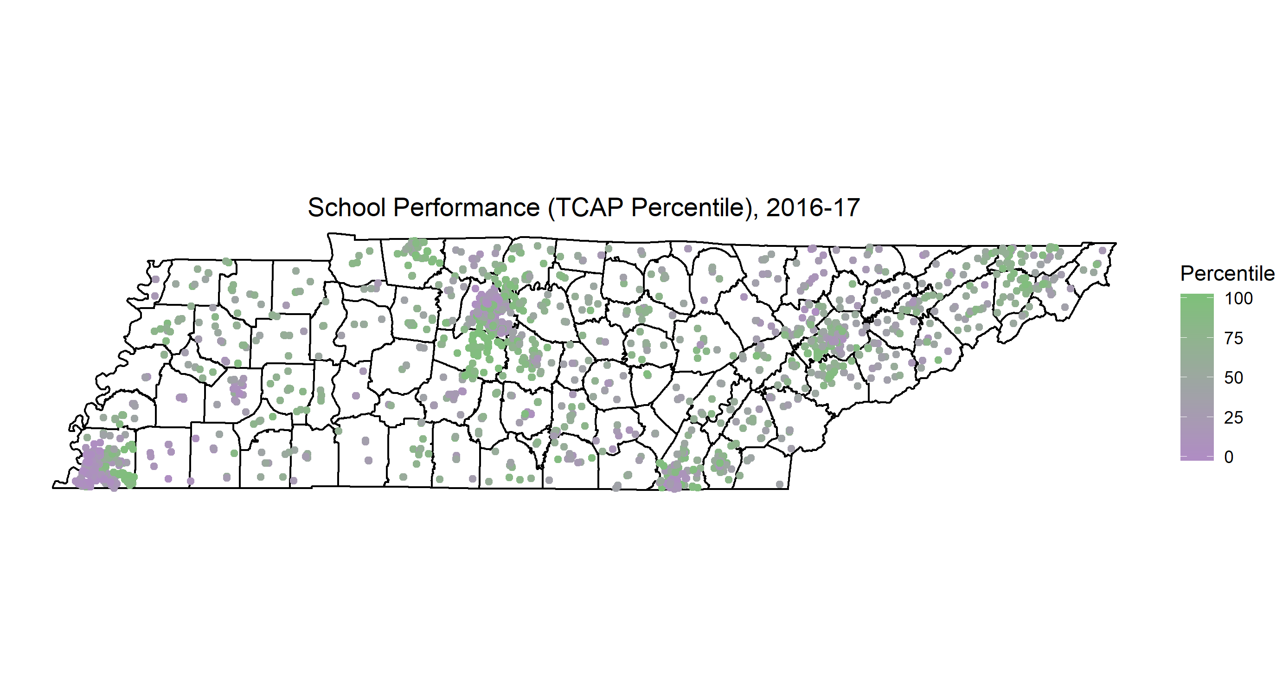
TCAP Percentiles

Slide 7

TCAP Percentiles

Slide 8

TVAAS Ranking

Slide 9
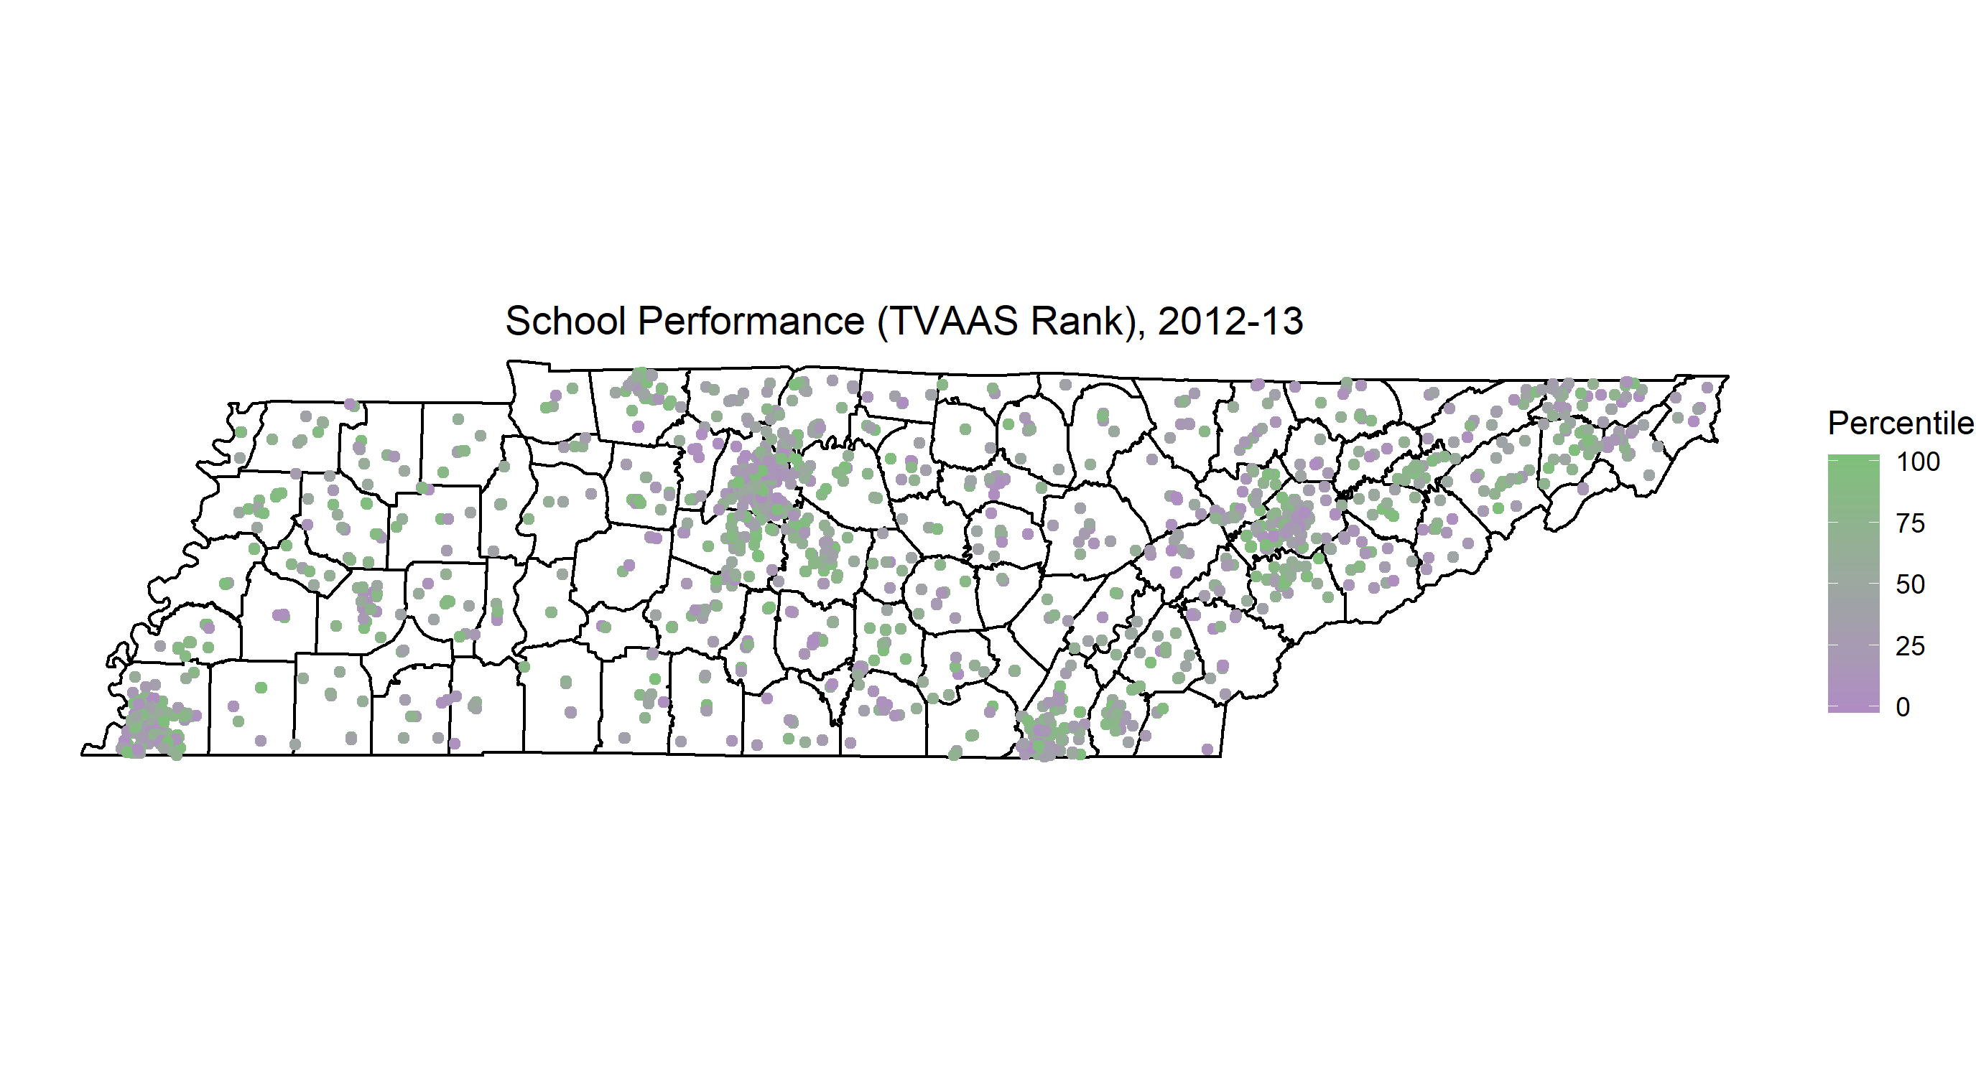
TVAAS Ranking

Slide 10
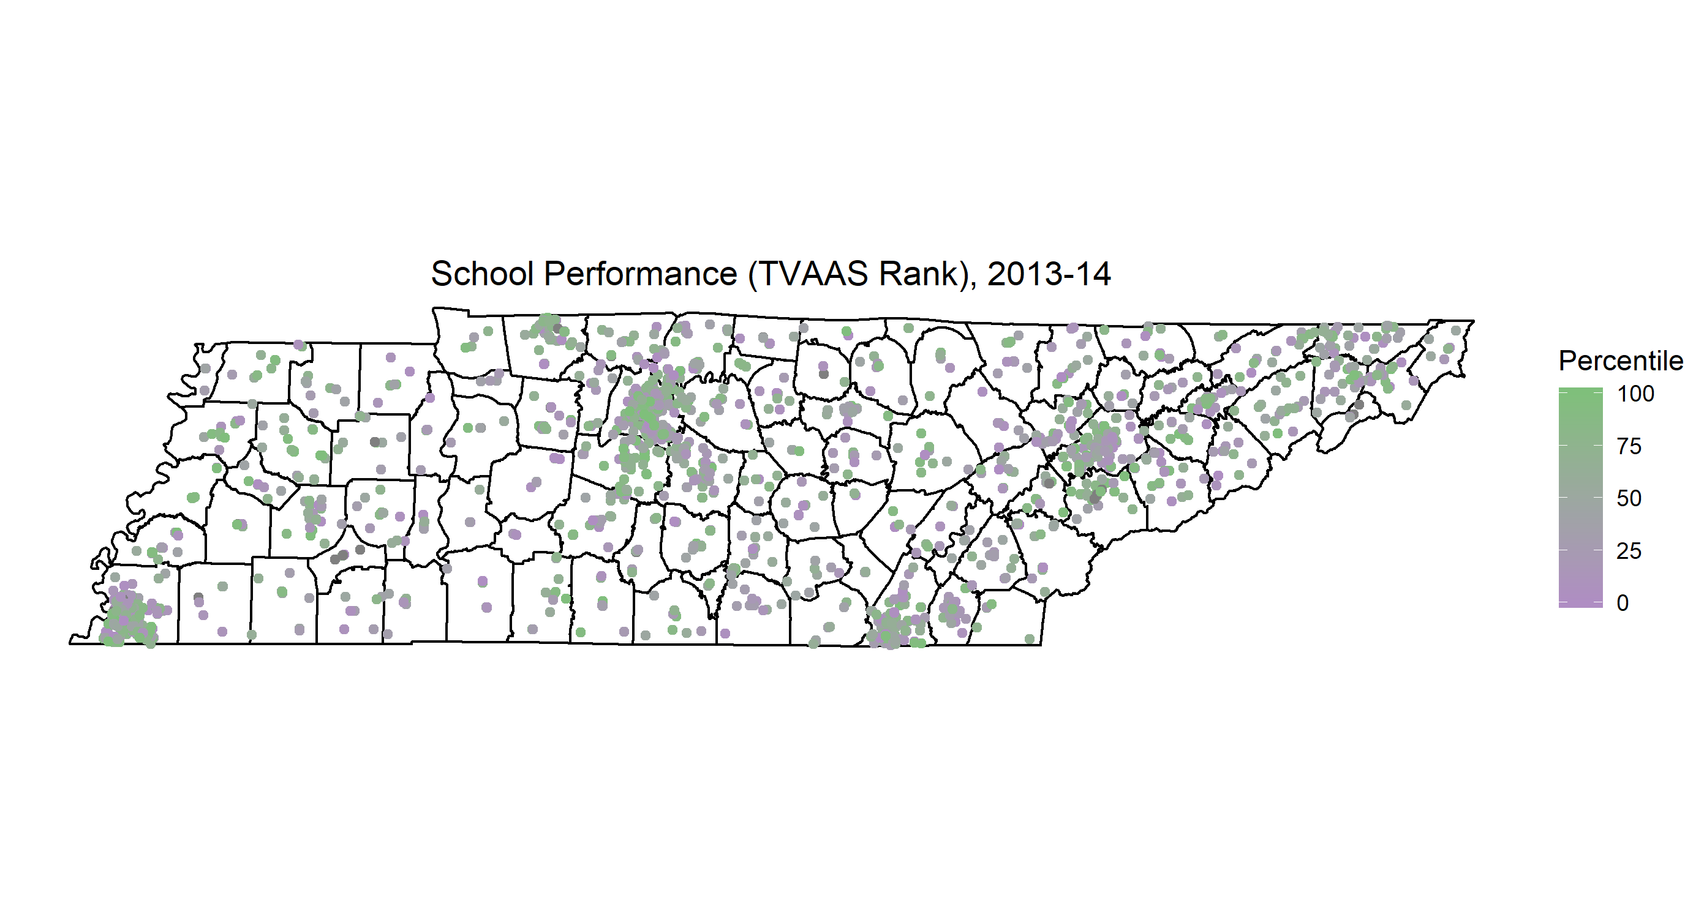
TVAAS Ranking

Slide 11

TVAAS Ranking

Slide 12
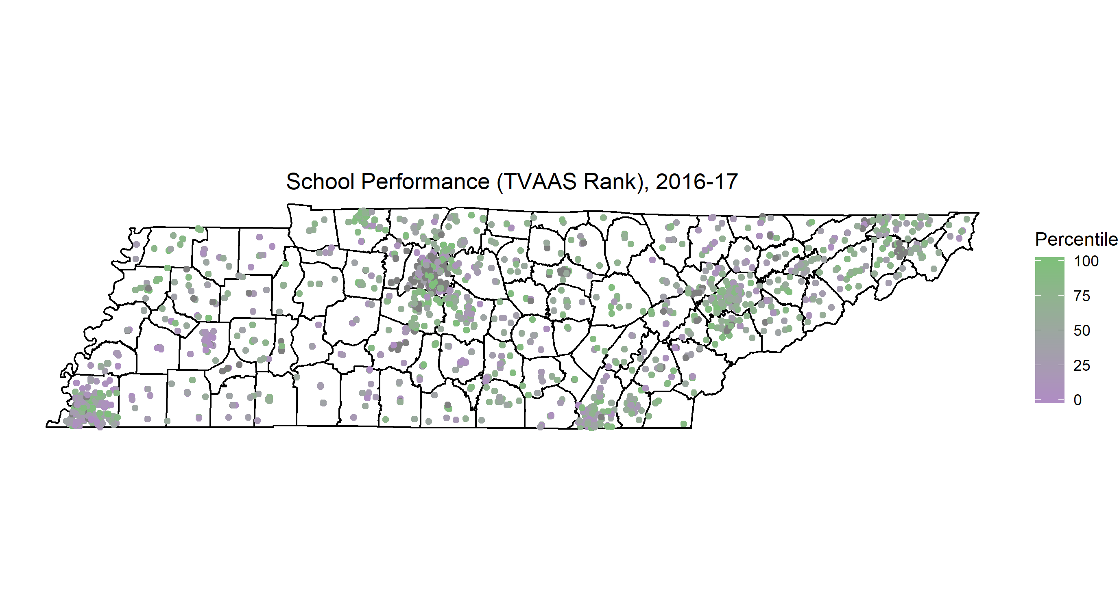
TVAAS Ranking

Slide 13
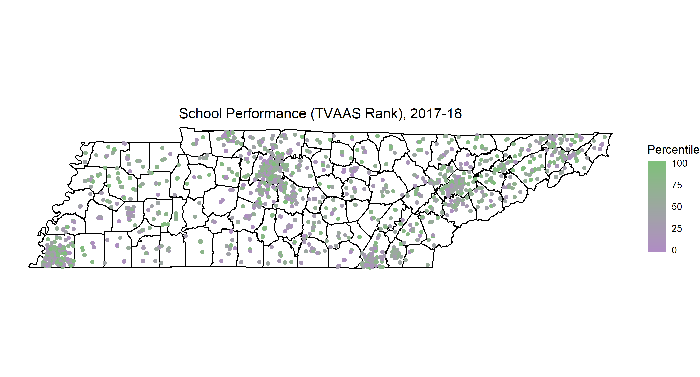
TVAAS Ranking

